Slide 1

HAJEE MOHAMMAD DANESH SCIENCE AND TECHNOLOGY UNIVERSITY,DINAJPUR-5200
PROJECT NAME : HSTU Admission System
Presentation by :
Name : Ashikur Rahman Bhuyain
Student Id: 1802071
(CSE 2018 BATCH)

Slide 2
OVERVIEW OF THIS PROJECT
REQUIRED LOGIN OR REGISTER AT THE BEGINNING TO
STORE THE USER INFO
WILL CHECK ADMISSION RESULT
WILL ADMIT A STUDENT
WILL CHECK ADMISSION STATUS AND SHOW INFORMATION
IF ADMISSION IS COMPLETED
EASY EXIT

Slide 3
LOGIN/REGISTER
MAIN MENU
Cheek result.
Admit a student.
Cheek if admission is completed.
View user profile.
Log out.
Exit code.

Slide 4
CHECK RESULT
SHOW MASSAGE IF SELECTED OR NOT SELECTED
Main menu.
Check another result.

Slide 5
ADMIT STUDENT
CHECK SELECTED FOR WHICH DEPARTMENT.
NAME
PARENTS NAME
DATE OF BIRTH
AUTO INFORMATION
STUDENT ID
ADMITTED BY
Main menu.
Check another result.

Slide 6
CHECK ADMISSION STATUS
CHECK IF ADMISSION IS COMPLETED .
NAME
PARENTS NAME
DATE OF BIRTH
ADMISSION ROLL
STUDENT ID
ADMITTED BY
Main menu.
Check another result.

Slide 7
USER PROFILE
USER NAME
MOBILE
EMAIL
LOG OUT
LOG IN
REGISTER
EXIT
EXIT
EXIT FROM CODE BY GIVING EXIT MASSAGE

Slide 8
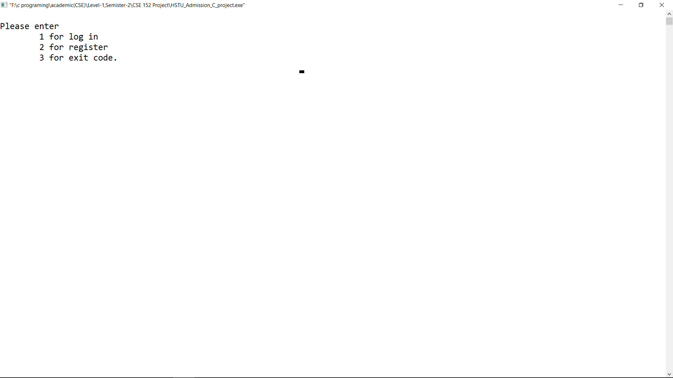
Login/signup option:

Slide 9
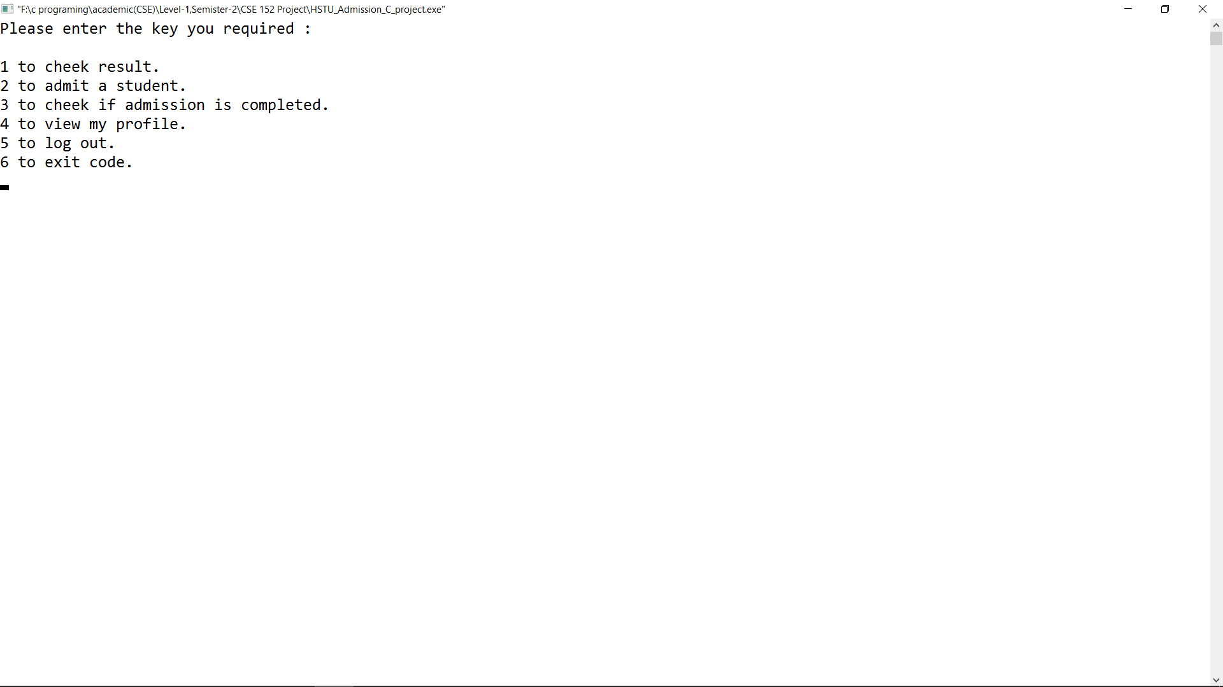
Main menu :

Slide 10
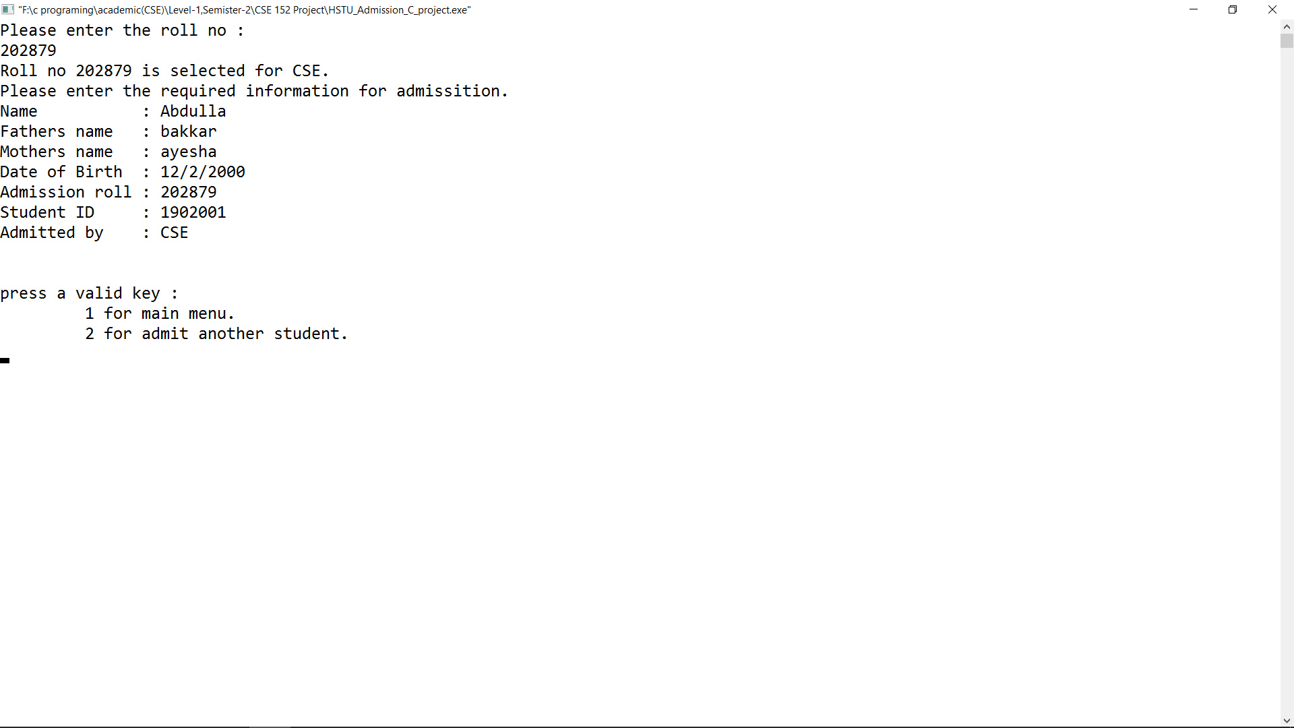
Admitting student :

Slide 11
THANK YOU ☺

